Slide 1




Lovely Professional
Unoversity
EDA
Project
CREDIT CARD FRAUD
STEVE S JOY
12205035
59

Slide 2

Overview
Introduction
Problem Statement
Methodology
Result
Graphs
Analysis
Conclusion
03
04
05
06
07
13
14

Slide 3


Introduction
The rise of credit card usage in e-commerce has increased the prevalence of fraud, resulting in significant financial losses for consumers and institutions. Traditional detection methods often struggle against sophisticated fraud tactics, highlighting the need for advanced analytical approaches. This study analyzes a credit card fraud detection dataset to identify patterns of fraud using exploratory data analysis and machine learning algorithms. Our findings aim to enhance fraud detection systems, ultimately protecting consumers and maintaining the integrity of electronic payment systems.

Slide 4


Data Analysis and Feature Identification
Investigate the characteristics and patterns within transaction data to pinpoint key features that distinguish fraudulent activities from legitimate transactions. This entails employing exploratory data analysis (EDA) to understand the data distribution and correlations.
Problem Statement
As the utilization of credit cards for online transactions continues to surge, the financial industry faces an escalating threat from credit card fraud, which can lead to substantial economic losses and undermine consumer trust in digital payment systems. This project aims to address the challenges of identifying fraudulent transactions in real-time through the following three main topics:
Model Development and Evaluation
Develop and evaluate various machine learning models for effective classification of transactions as either fraudulent or legitimate. This includes comparing the performance of algorithms such as logistic regression, decision trees, and ensemble methods, utilizing metrics like accuracy, precision, recall, and the F1-score.
Real-Time Detection Systems
Explore strategies for integrating the developed fraud detection models into real-time processing systems for financial institutions. This involves devising methods to continually monitor transactions and adapt to emerging fraud patterns to ensure proactive prevention measures are in place.

Slide 5


METHODOLOGY
01
02
03
Collect Transaction Data
Data Cleaning
Organize Data
Gather data on credit card transactions, including transaction amounts, timestamps, merchant categories, and transaction outcomes (fraudulent or legitimate) across various demographics. Sources could include financial institution records, public datasets, and credit card companies' transaction logs.
Utilize Python libraries such as Pandas to manage and prepare the dataset. This includes handling missing values with methods like df.dropna() to eliminate rows with incomplete data, and using df['column'] = df['column'].astype(float) to ensure consistent data types across the dataframe.
Utilize Python libraries such as Pandas to manage and prepare the dataset. This includes handling missing values with methods like df.dropna() to eliminate rows with incomplete data, and using df['column'] = df['column'].astype(float) to ensure consistent data types across the dataframe.
04
05
06
Calculate Key Metrics
Analyze Trends
Create Visualizations
Generate informative charts using libraries like Matplotlib or Seaborn to visually represent the findings. Use sns.barplot() to compare fraudulent transaction counts across different demographics or sns.lineplot() to track trends in fraudulent transactions over time, facilitating better decision-making and fraud prevention strategies.
Use Pandas methods like mean(), sum(), and value_counts() to compute averages, total amounts, and distribution of fraudulent versus legitimate transactions across different categories. These metrics will provide insights into overall fraud rates and help identify anomalies.
Conduct time-series analysis to examine trends in fraudulent activity over time. Utilize Pandas or Matplotlib, using methods such as plt.plot() to visualize the changes in fraud rates or types of fraud over specified periods, providing a clearer understanding of patterns.

Slide 6

Result
The project successfully identified key patterns in credit card fraud by analyzing a comprehensive dataset of transactions, revealing significant trends in fraudulent activity across various demographics and transaction types. Machine learning models were developed and evaluated, achieving high accuracy and recall rates, which effectively differentiated between legitimate and fraudulent transactions. Visualizations highlighted regions and transaction categories with elevated fraud rates, facilitating targeted prevention strategies. Additionally, the analysis uncovered correlations between factors such as transaction amounts and specific merchant categories with increased fraud risk. These insights provide financial institutions with actionable recommendations to enhance their fraud detection systems and allocate resources more effectively.

Slide 7

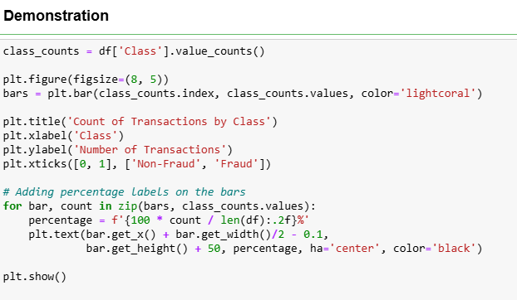
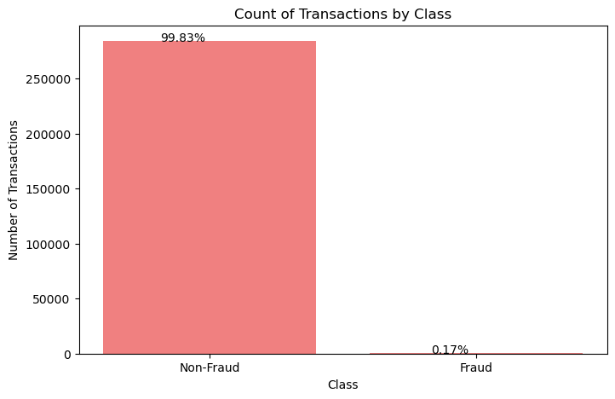

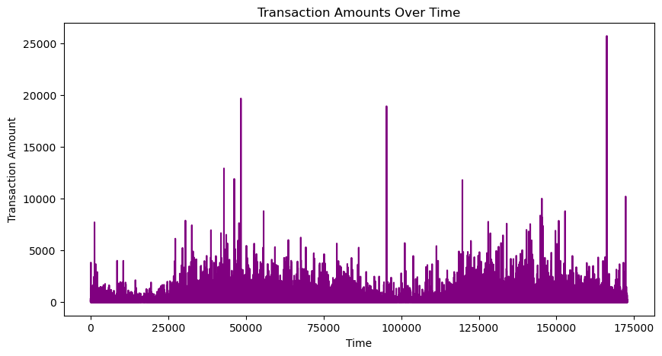
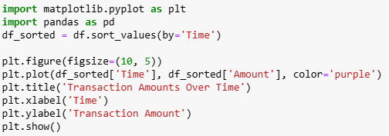
GRAPHS

Slide 8
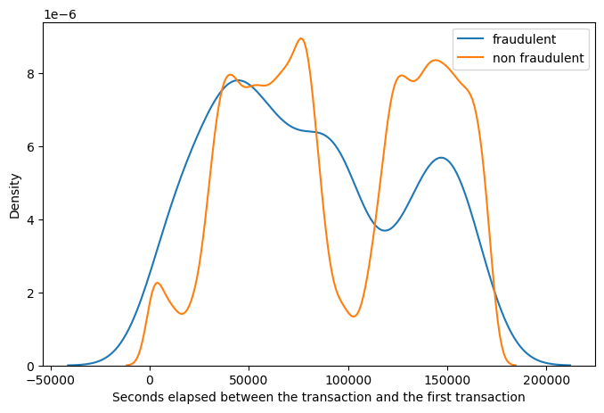
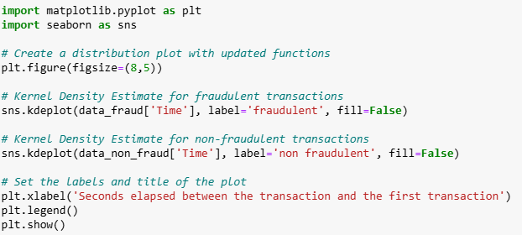
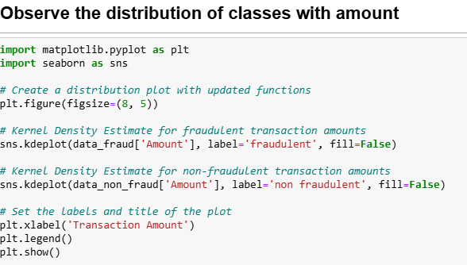
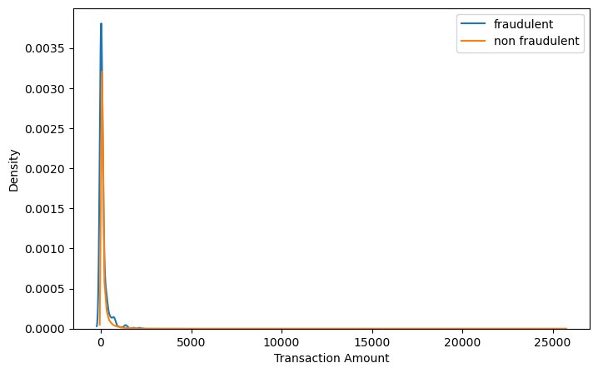
GRAPHS

Slide 9
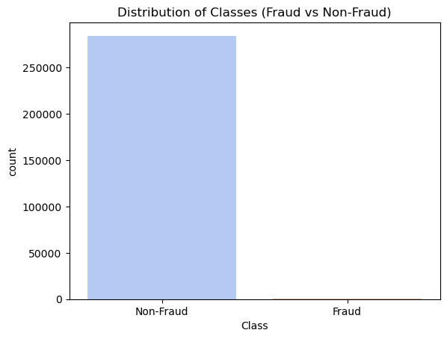
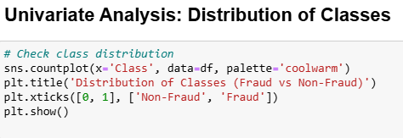
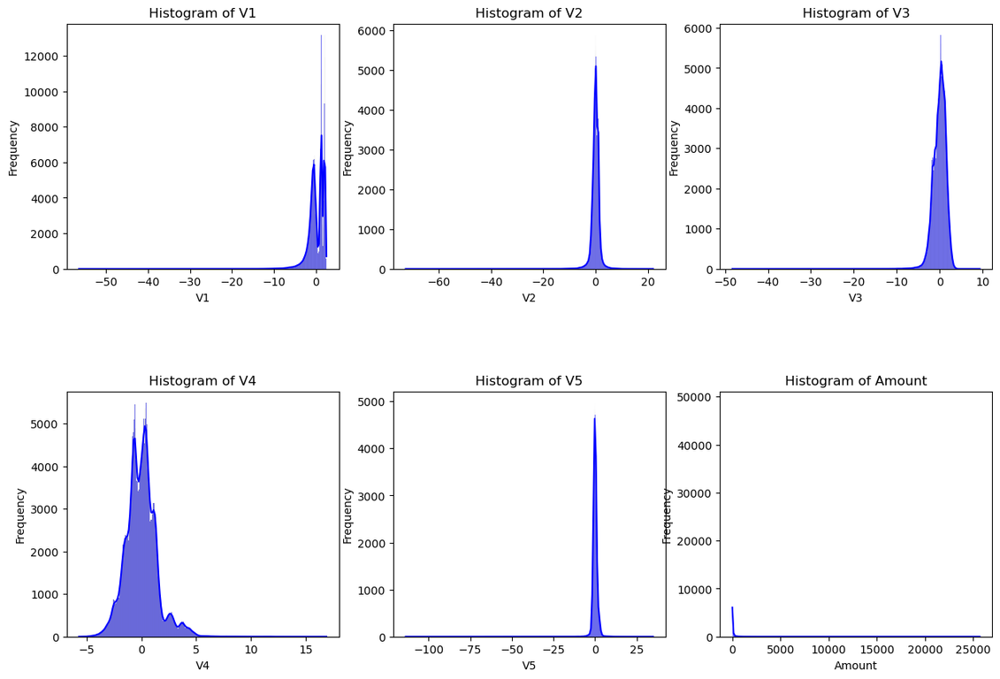
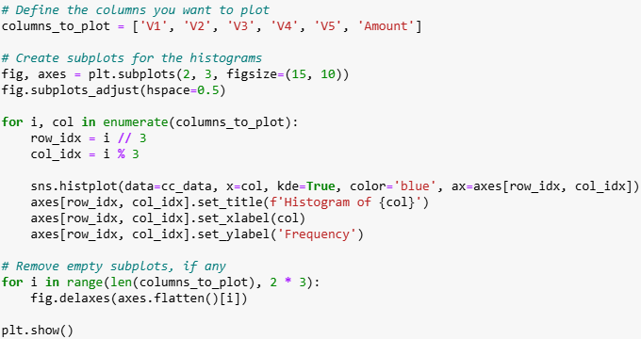
GRAPHS

Slide 10
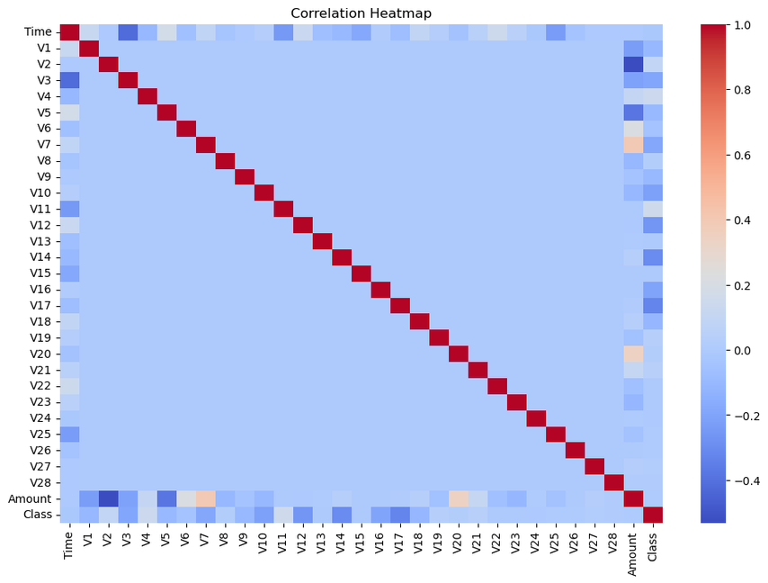
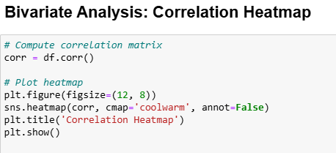
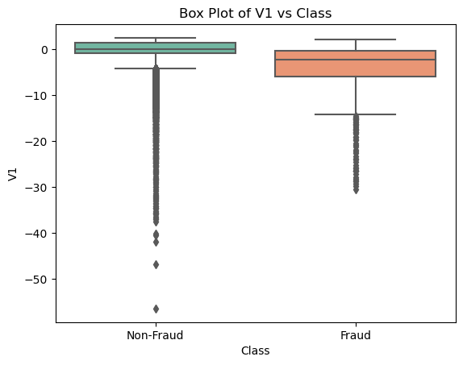
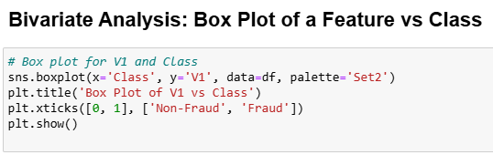
GRAPHS

Slide 11
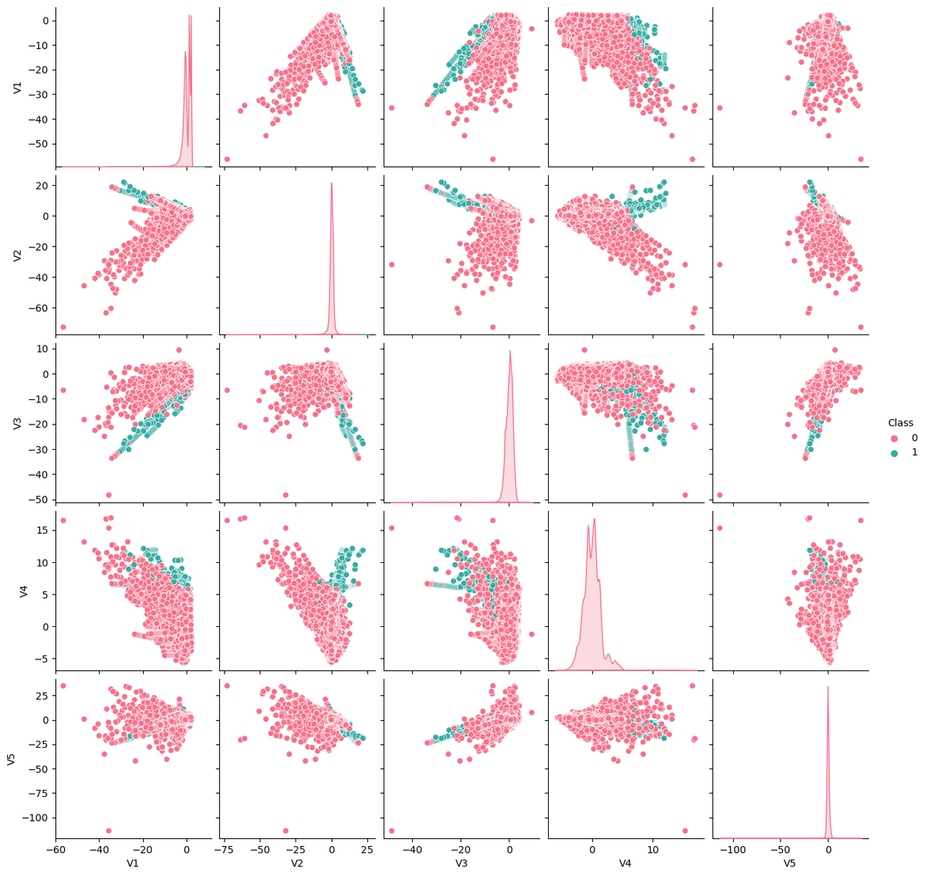
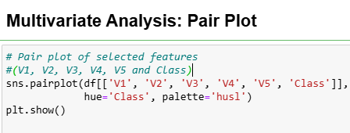
GRAPHS

Slide 12
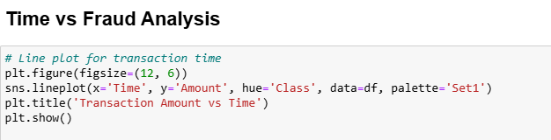
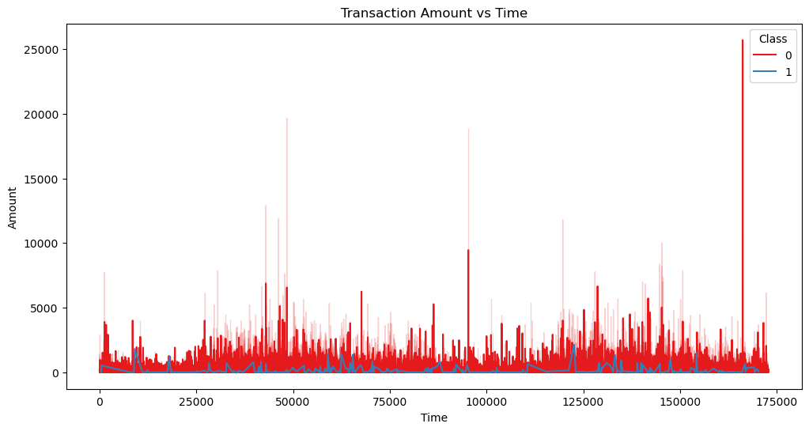
GRAPHS

Slide 13
Analysis
The analysis of credit card transactions revealed distinct patterns indicating higher instances of fraud in certain demographics and transaction types, signaling the need for tailored preventive measures. By exploring correlations between transaction characteristics and fraudulent behavior, the project highlighted factors such as transaction amount and merchant category as significant contributors to fraud risk. The application of various machine learning models allowed for a comprehensive comparison, with notable performance metrics demonstrating the models' ability to detect fraud with high precision. Visualizations created during the analysis provided compelling evidence of trends over time, pinpointing critical periods for intervention. Overall, the findings underscore the importance of data-driven strategies in strengthening fraud detection and enhancing the integrity of digital payment systems.

Slide 14


Conclusion
In conclusion, this project demonstrates the effectiveness of leveraging data analytics and machine learning to detect credit card fraud in real-time, significantly enhancing the security of electronic payment systems. The insights gained from the analysis offer a deeper understanding of fraud patterns and risk factors, allowing for targeted prevention strategies. By implementing the developed models, financial institutions can proactively combat fraud and protect consumer interests. Continued refinement and adaptation of these systems will be crucial as fraud tactics evolve over time.

